Slide 1
FIFA World Cup Analysis using Azure
A comprehensive analysis using Azure Data Factory, Databricks, Synapse, and Power BI

Slide 2
Introduction
Project Title: FIFA World Cup Analysis using Azure
Tools and Technologies: (Azure Data Factory, Databricks, Synapse, Power BI, etc.)
Database Reference: Kaggle

Slide 3
Stage 1: Data Ingestion
Creating a Pipeline in Data Factory
Activities: Lookup and For Each
Data Flow: From GitHub to Data Lake Gen 2 Storage

Slide 4
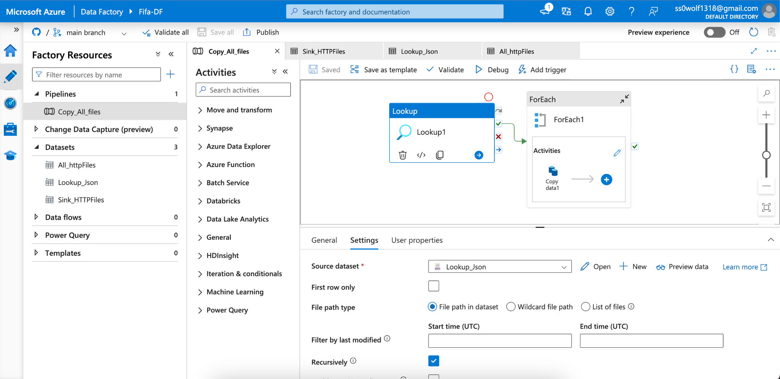
Stage 1: Data Ingestion

Slide 5
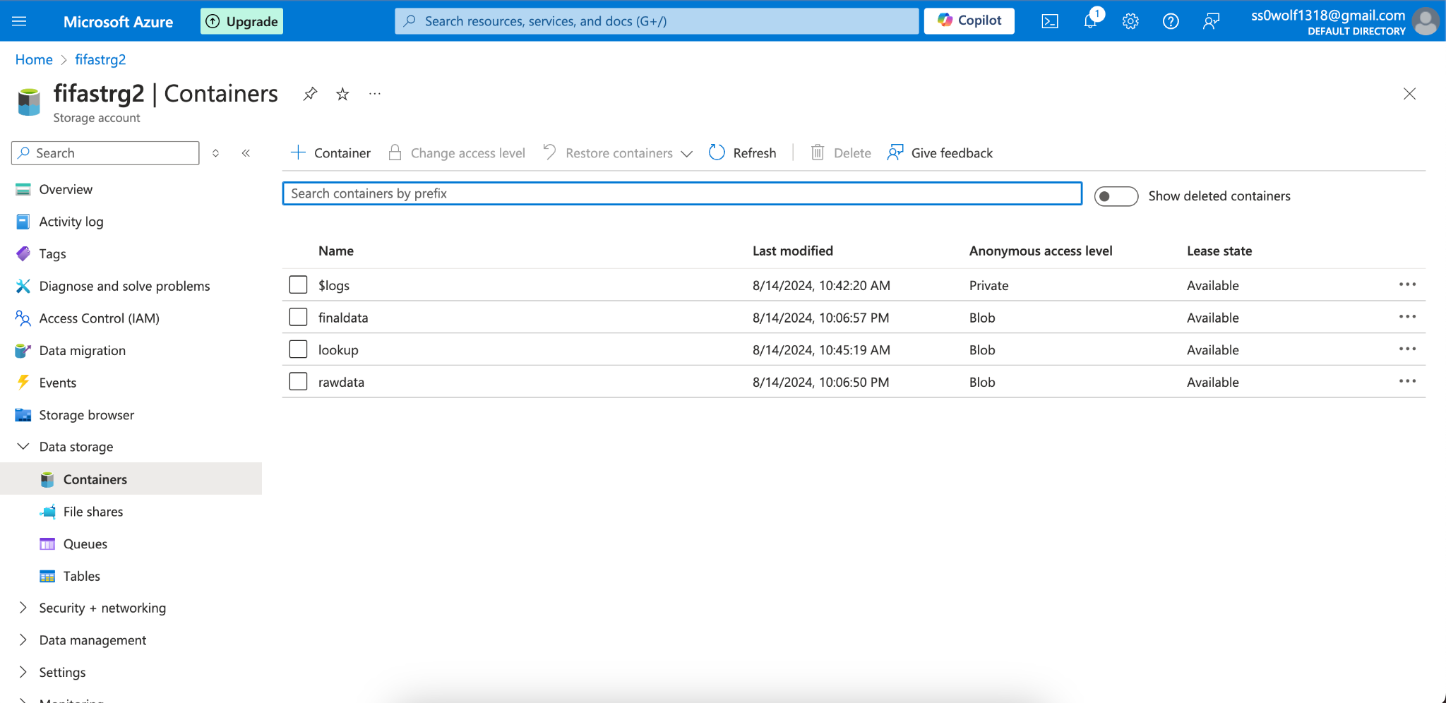
Stage 1: Data Ingestion

Slide 6
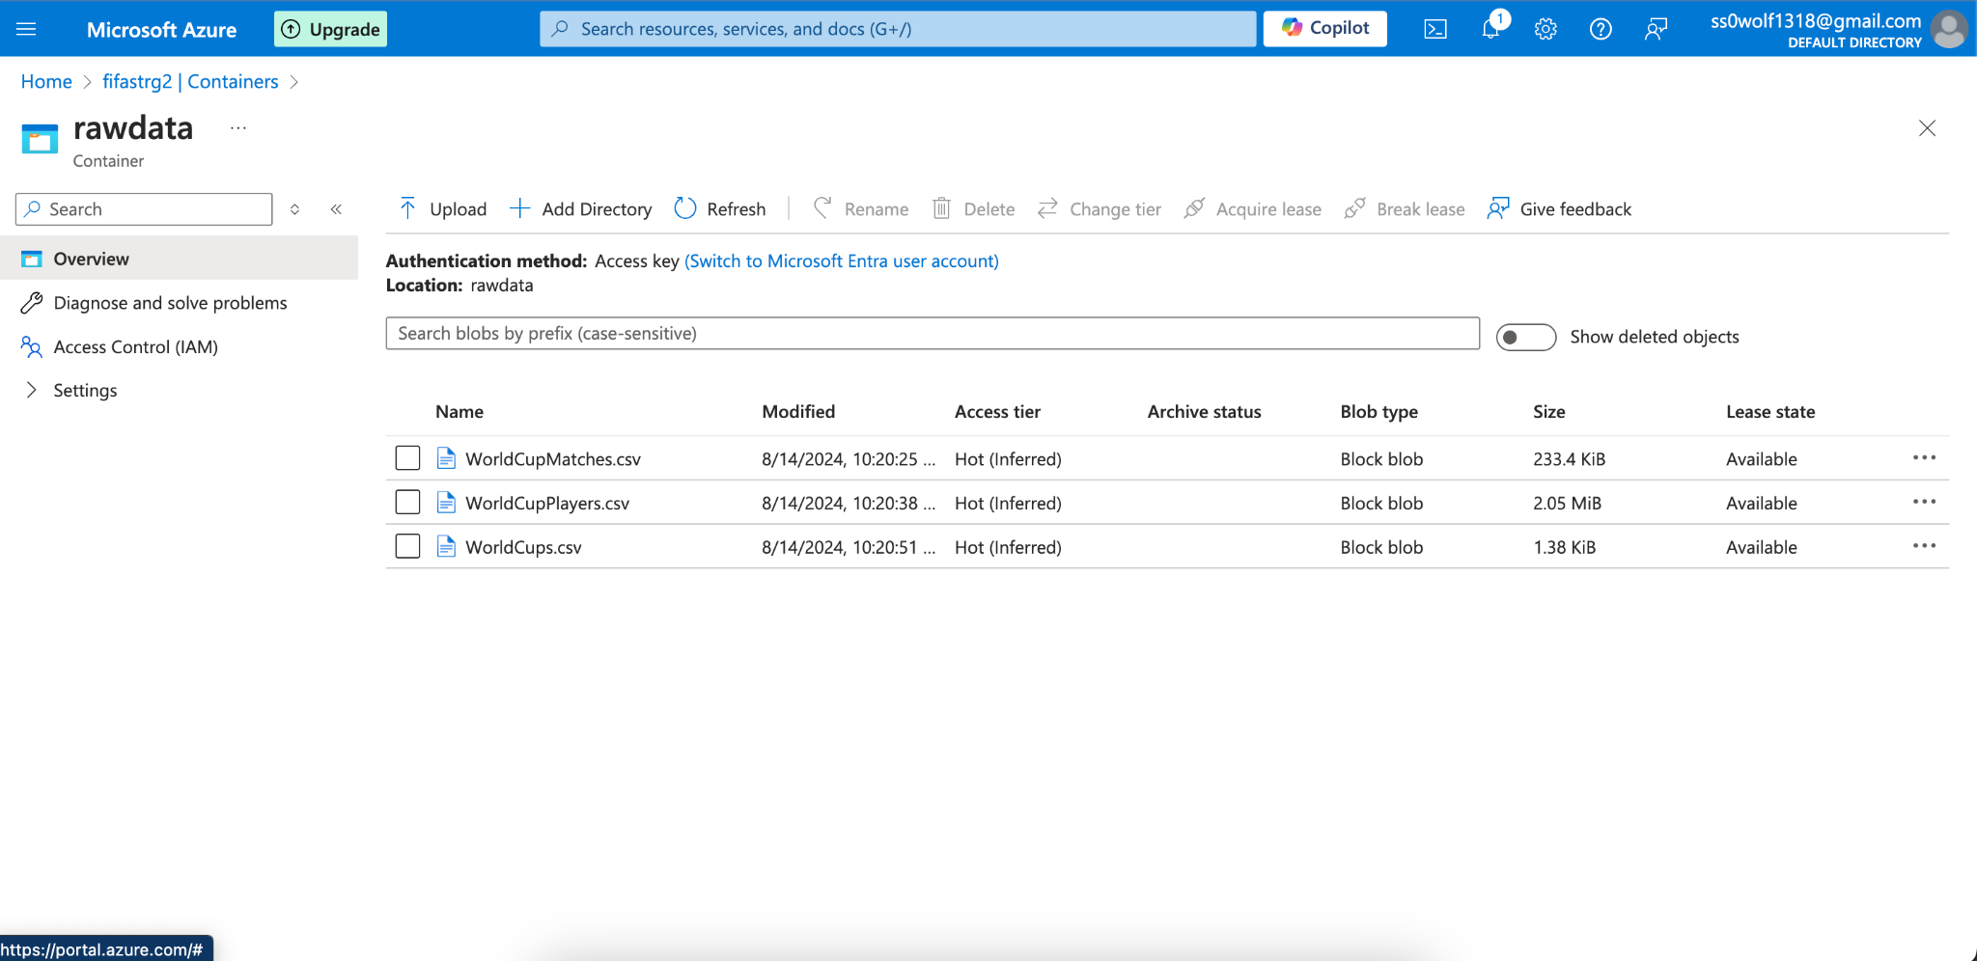
Stage 1: Data Ingestion

Slide 7
Stage 2: Security and Configuration
Creating a Service Principal & App Registration
Registering Secret Key
Storing Secrets in Key Vault

Slide 8
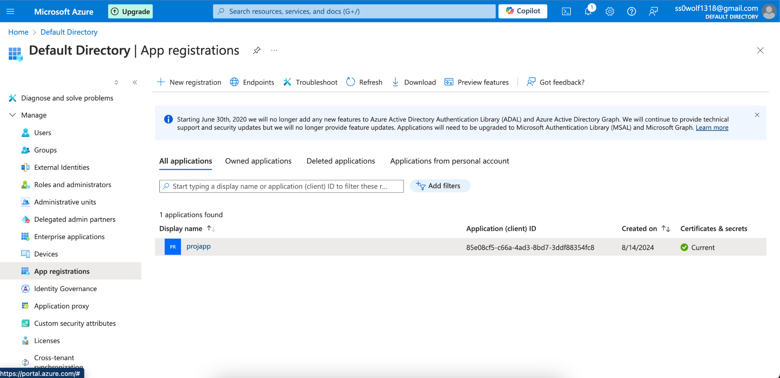
Stage 2: Security and Configuration

Slide 9
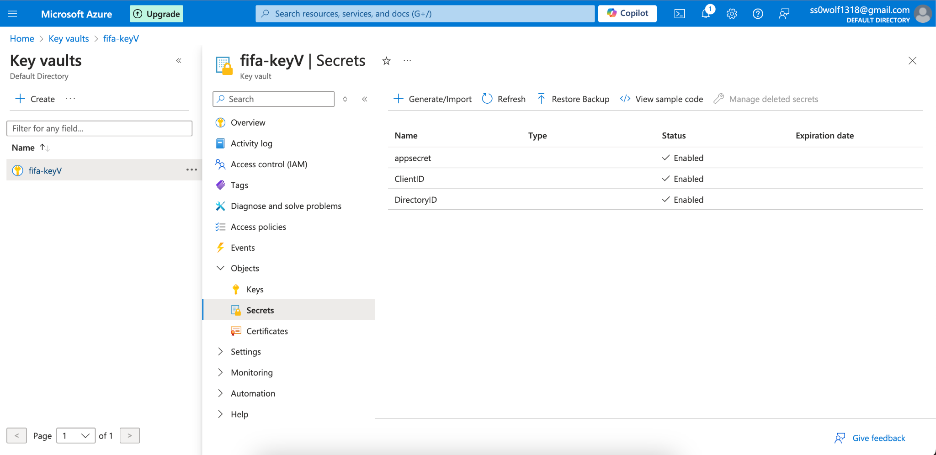
Stage 2: Security and Configuration

Slide 10
Stage 3: Data Transformation
Using Service Principal in Databricks
Accessing Storage Account and Raw Data
Transforming Data and Storing in Final Data Container

Slide 11
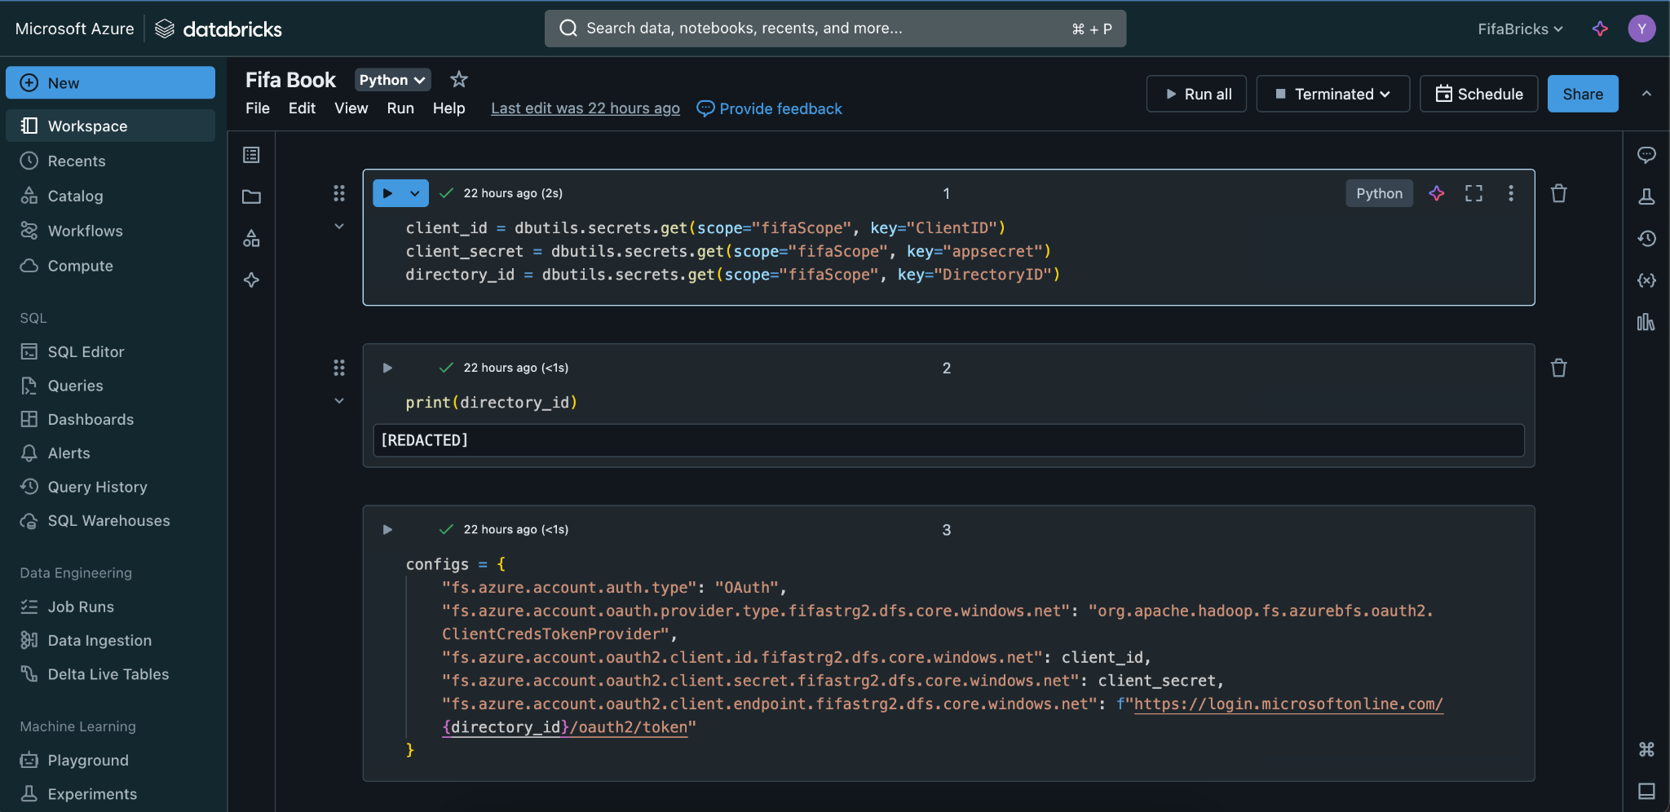
Stage 3: Data Transformation

Slide 12
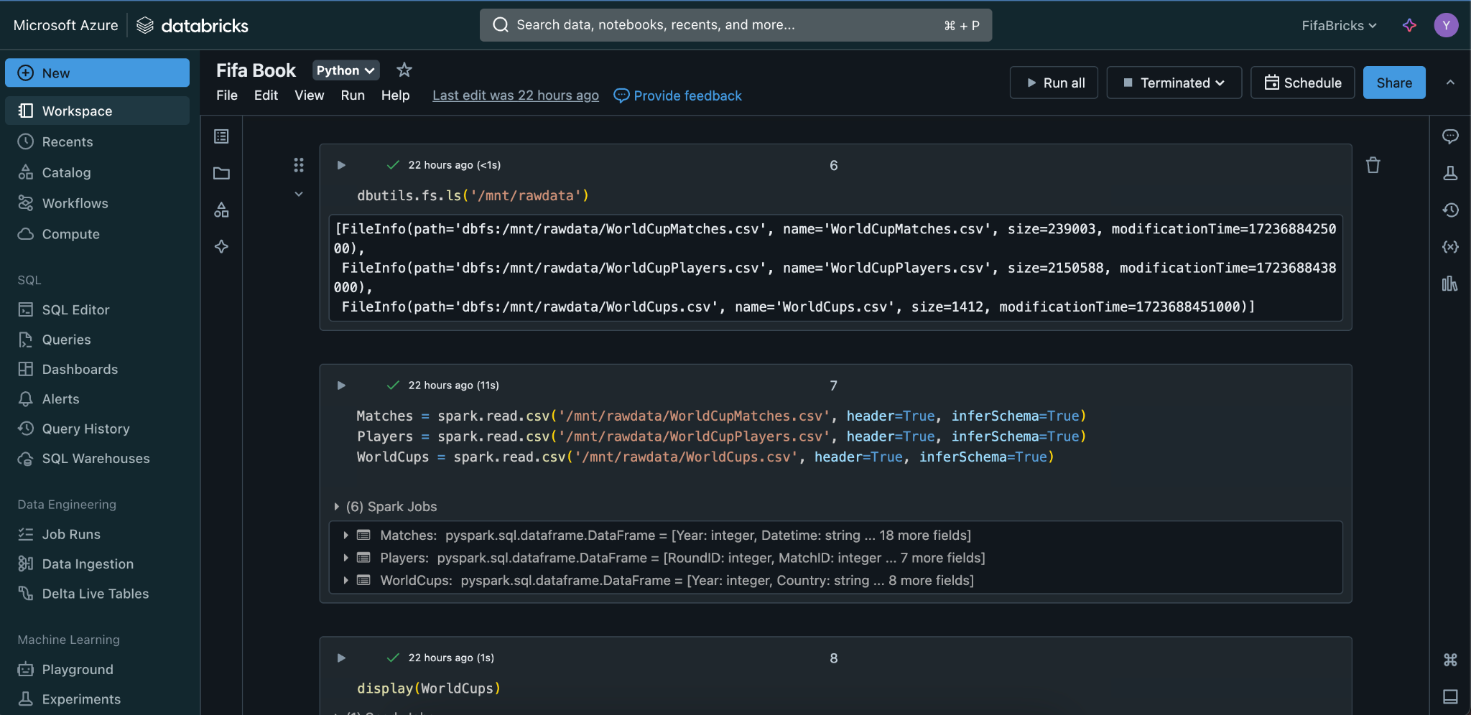
Stage 3: Data Transformation

Slide 13
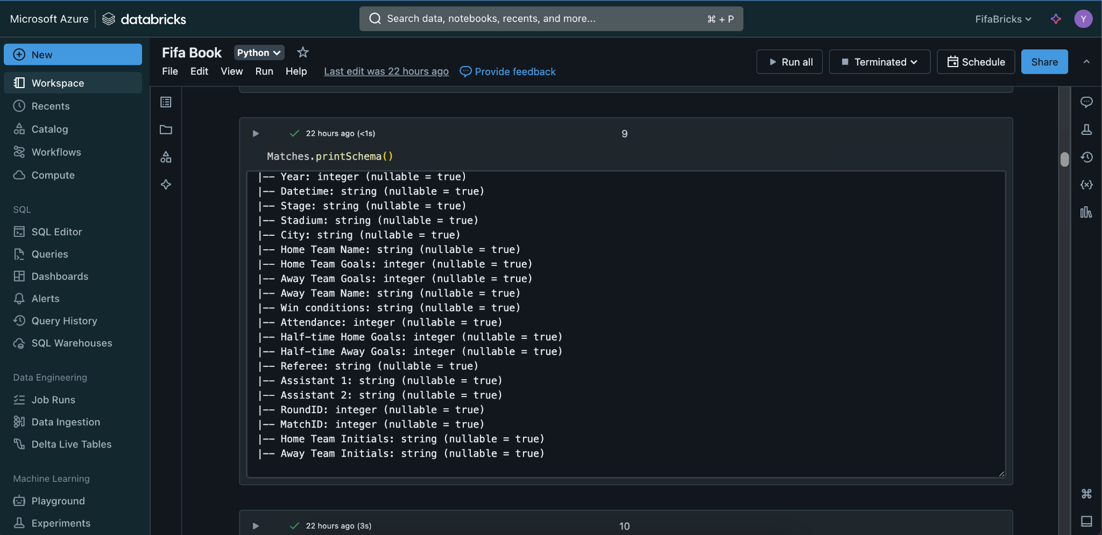
Stage 3: Data Transformation

Slide 14
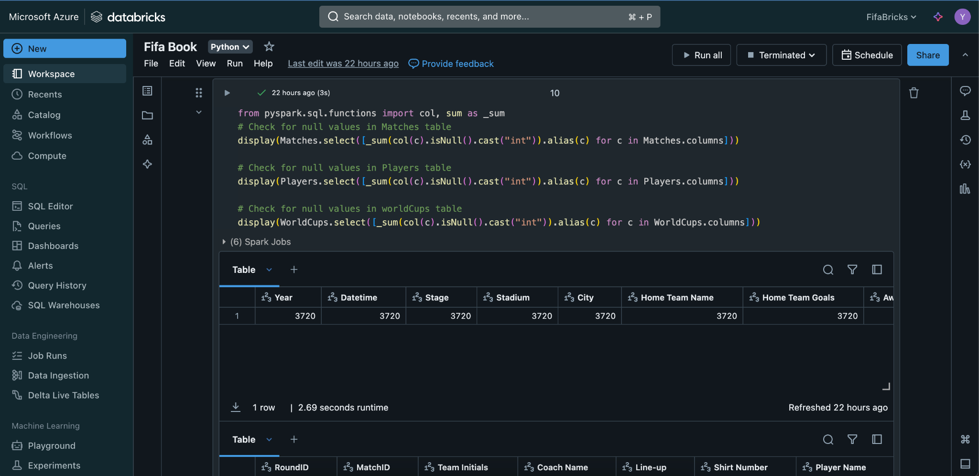
Stage 3: Data Transformation

Slide 15
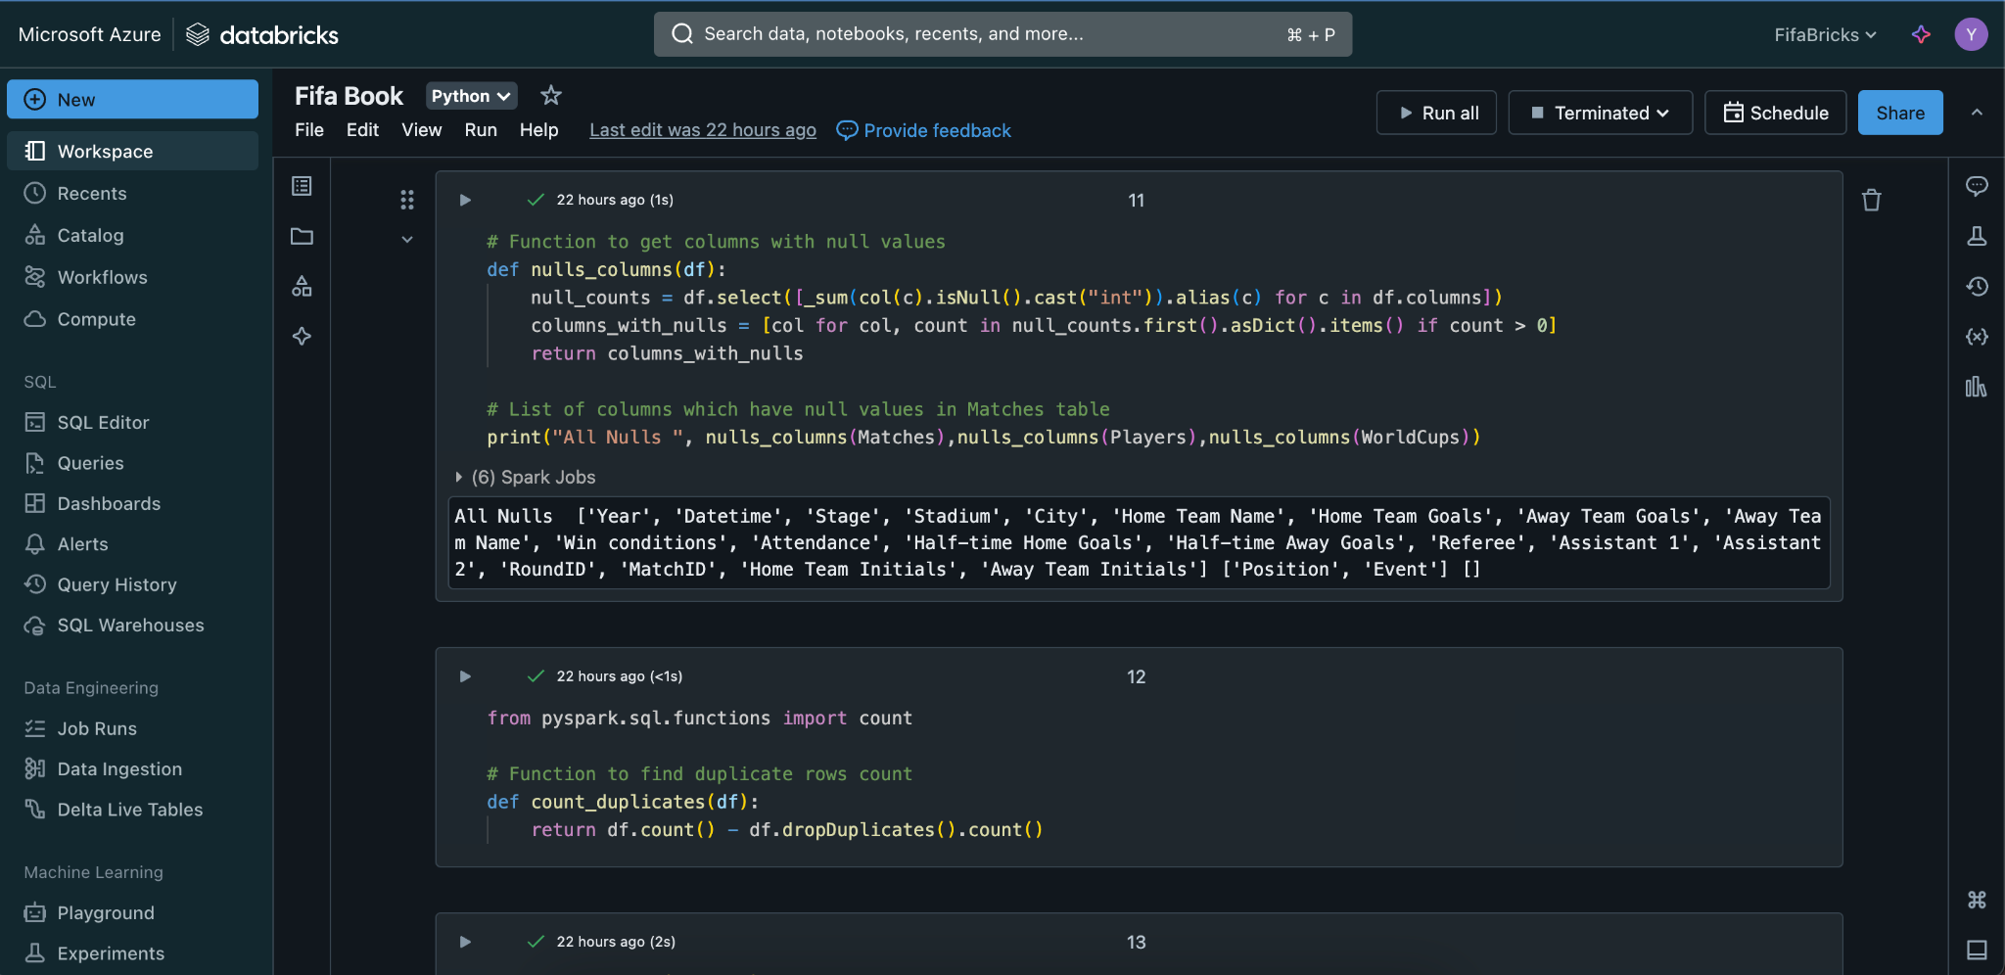
Stage 3: Data Transformation

Slide 16
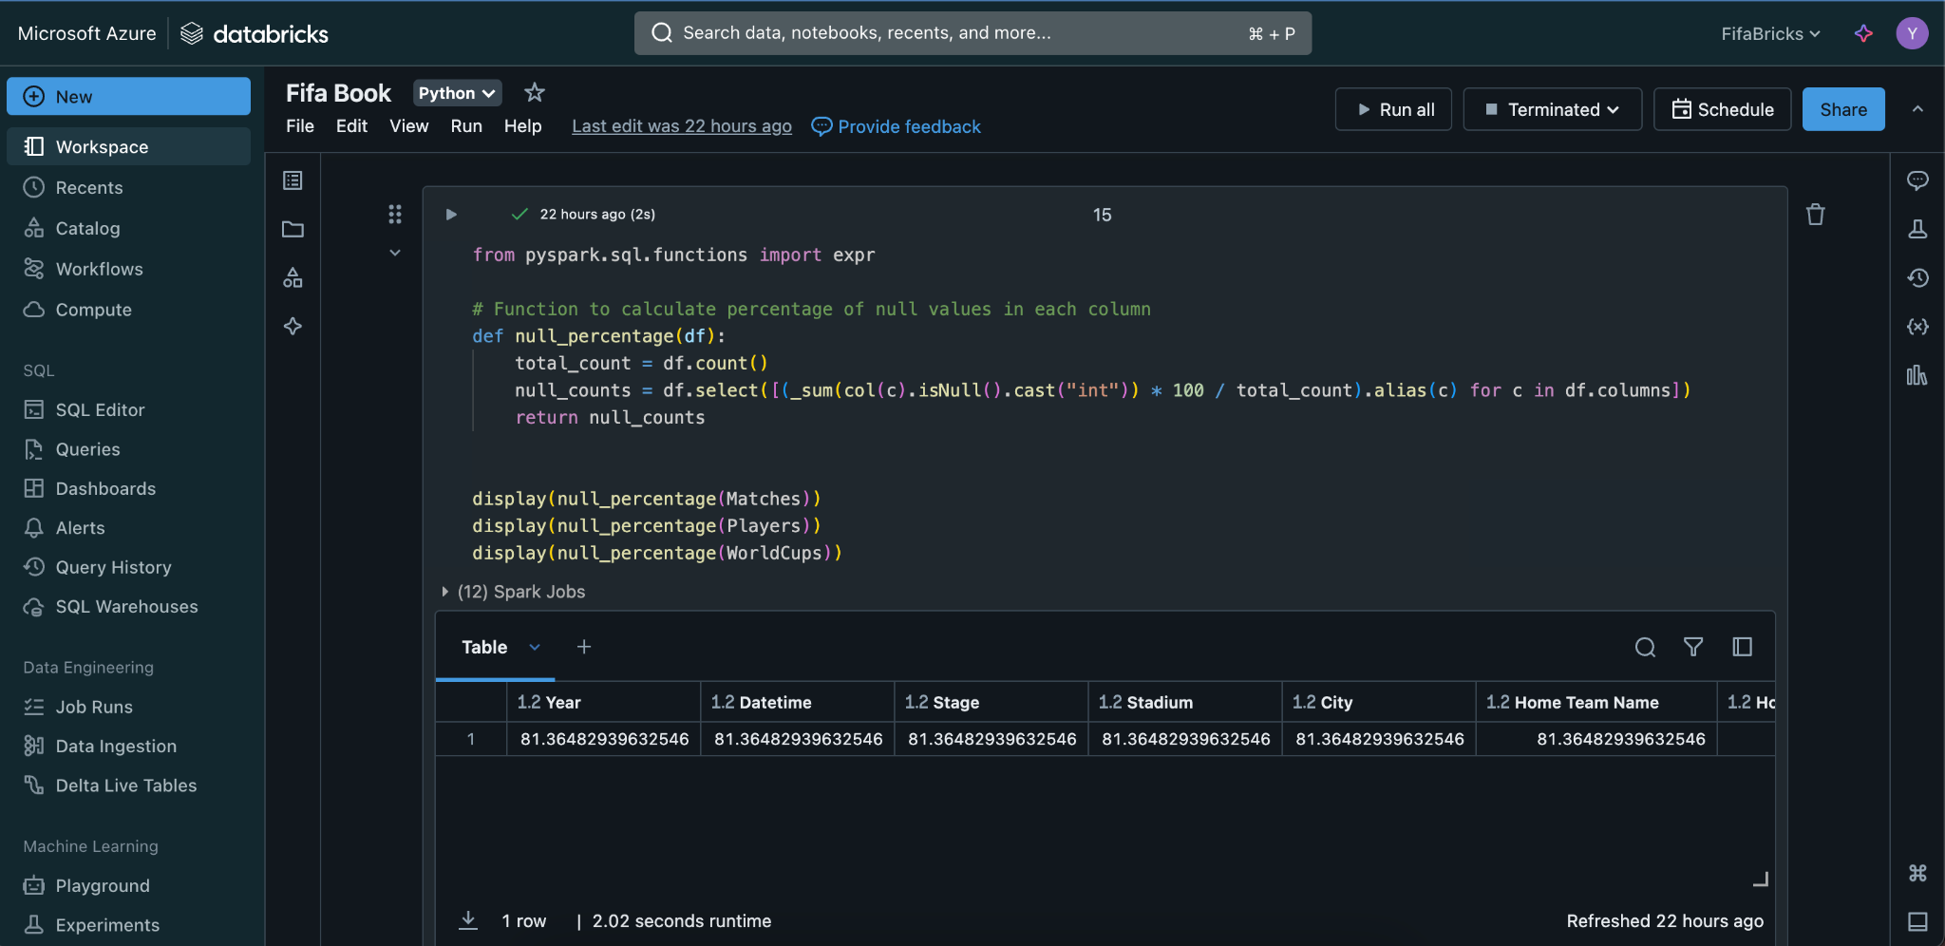
Stage 3: Data Transformation

Slide 17
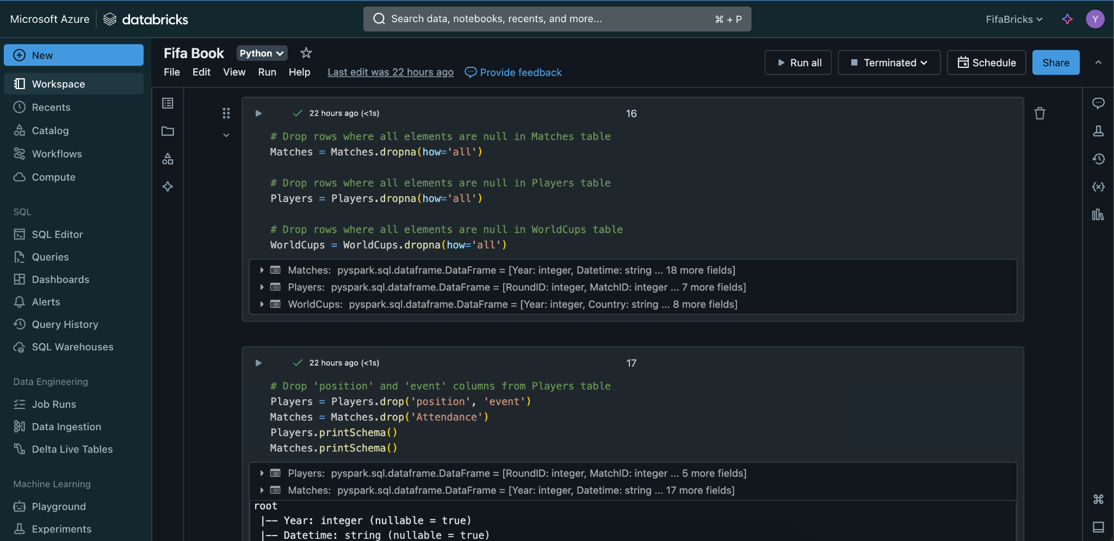
Stage 3: Data Transformation

Slide 18
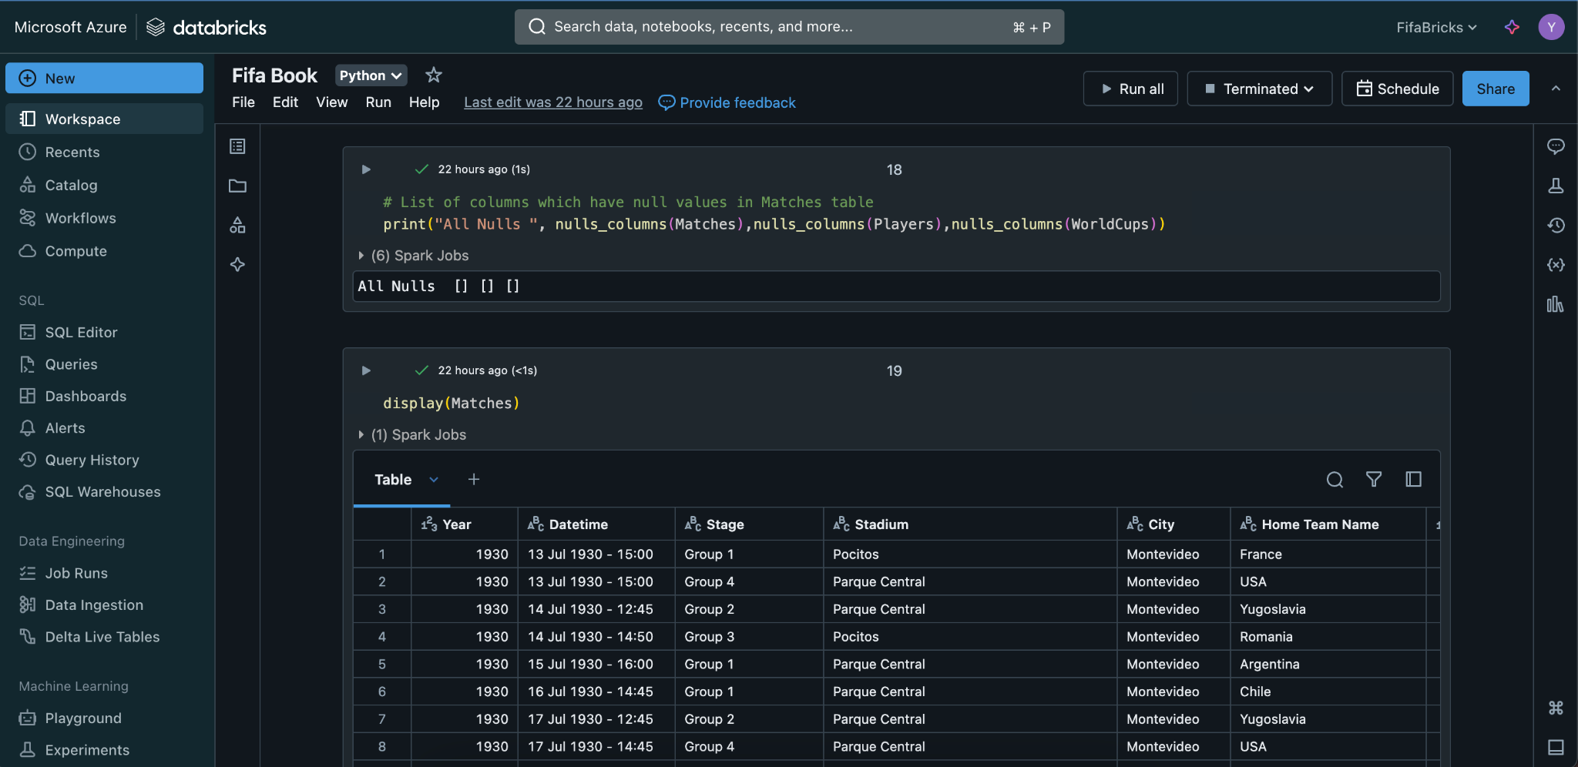
Stage 3: Data Transformation

Slide 19
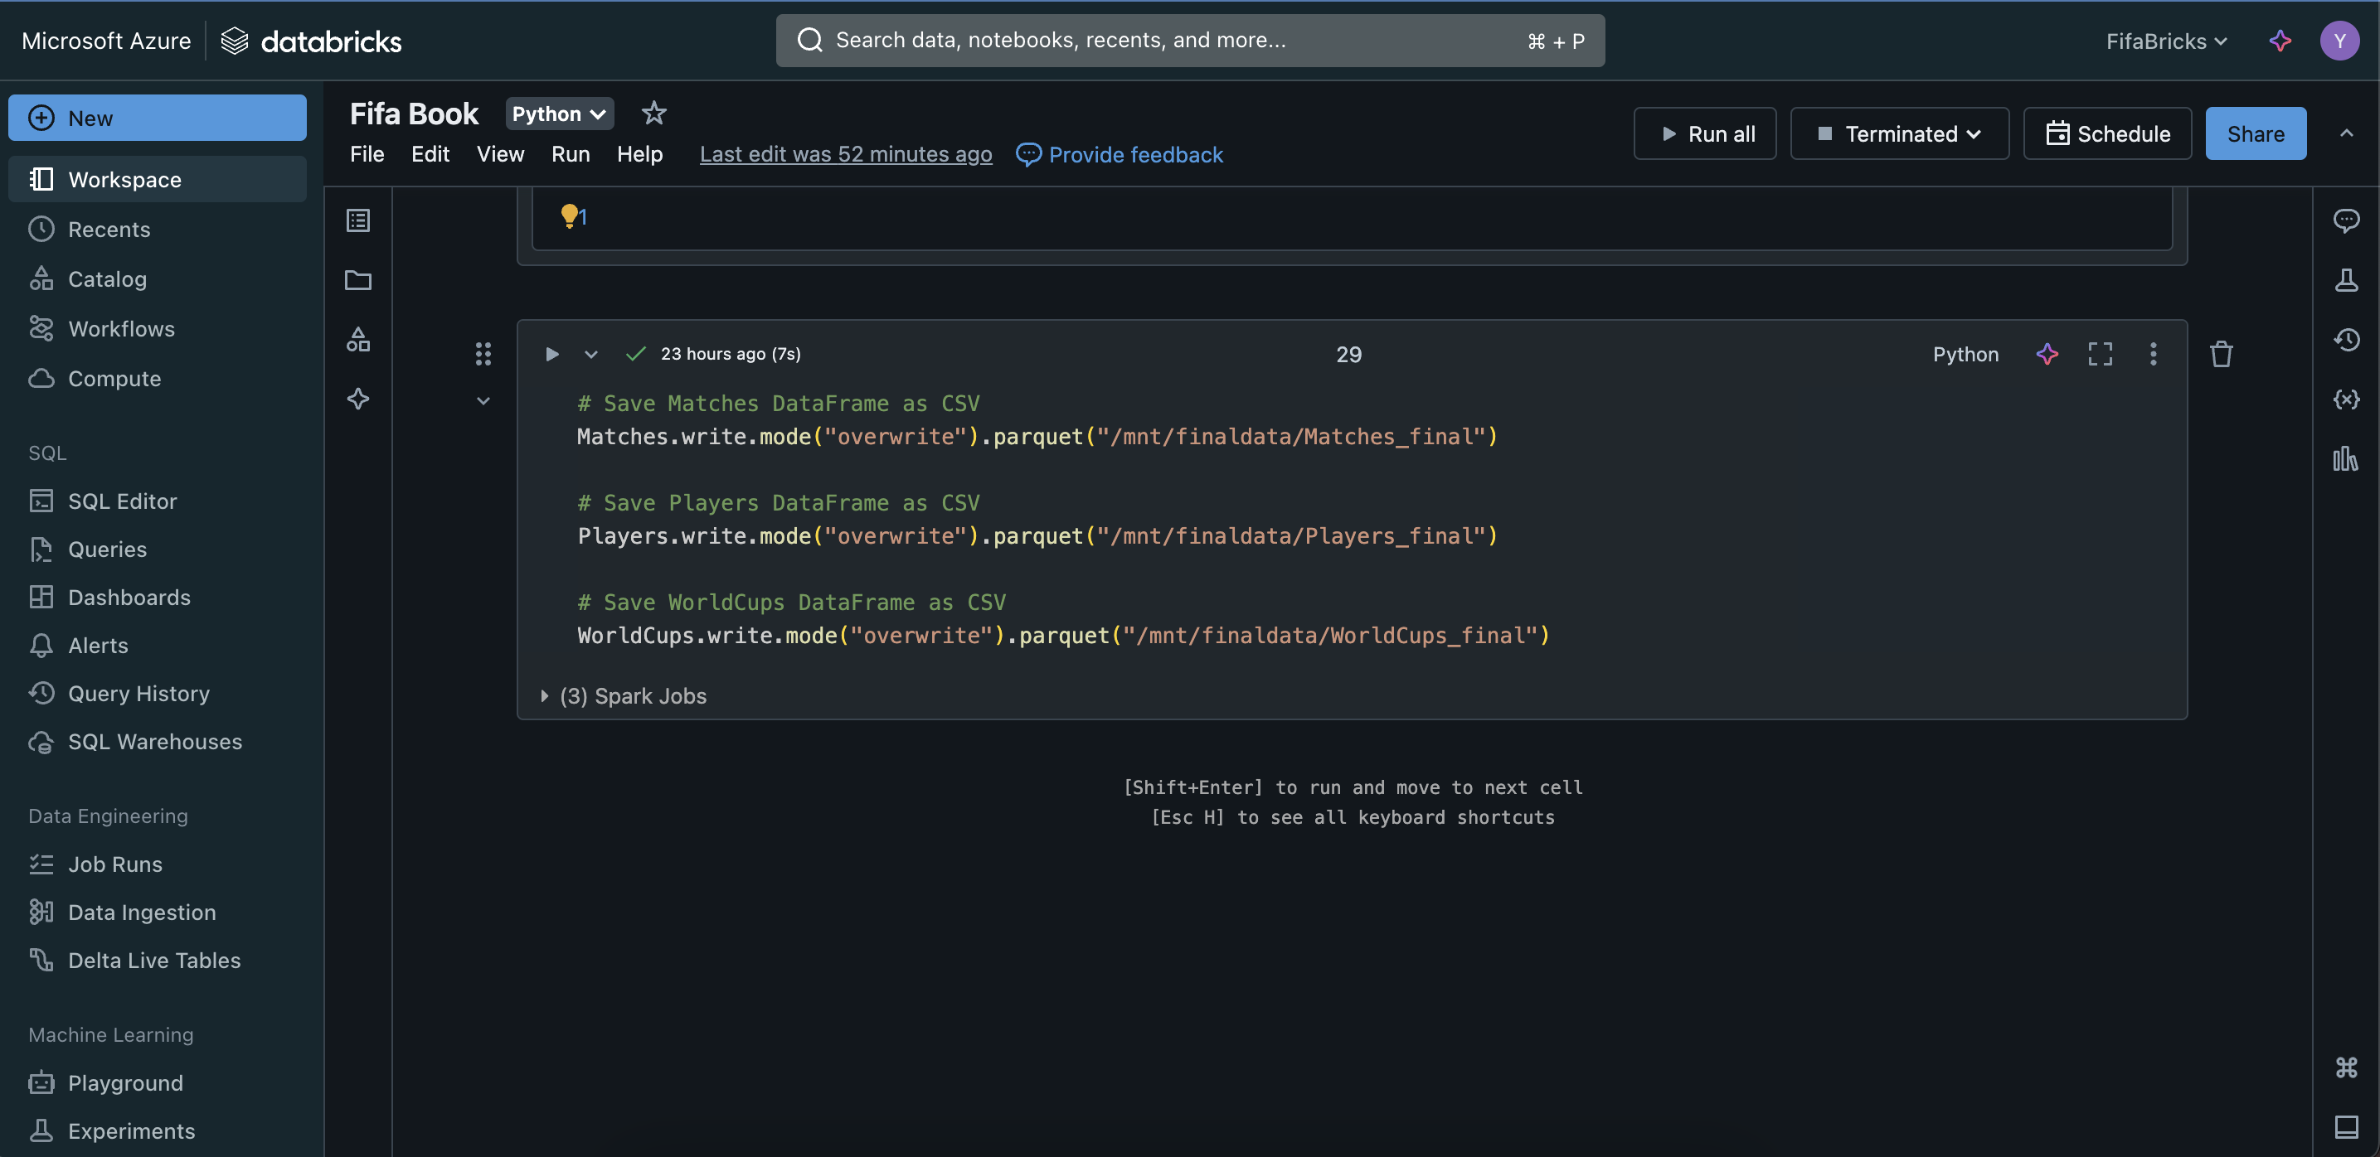
Stage 3: Data Transformation

Slide 20
Stage 4: Data Modeling
Creating Synapse and Serverless Pool
Setting Up Linked Service to SQL Database
Dynamic View Creation Using Pipeline

Slide 21
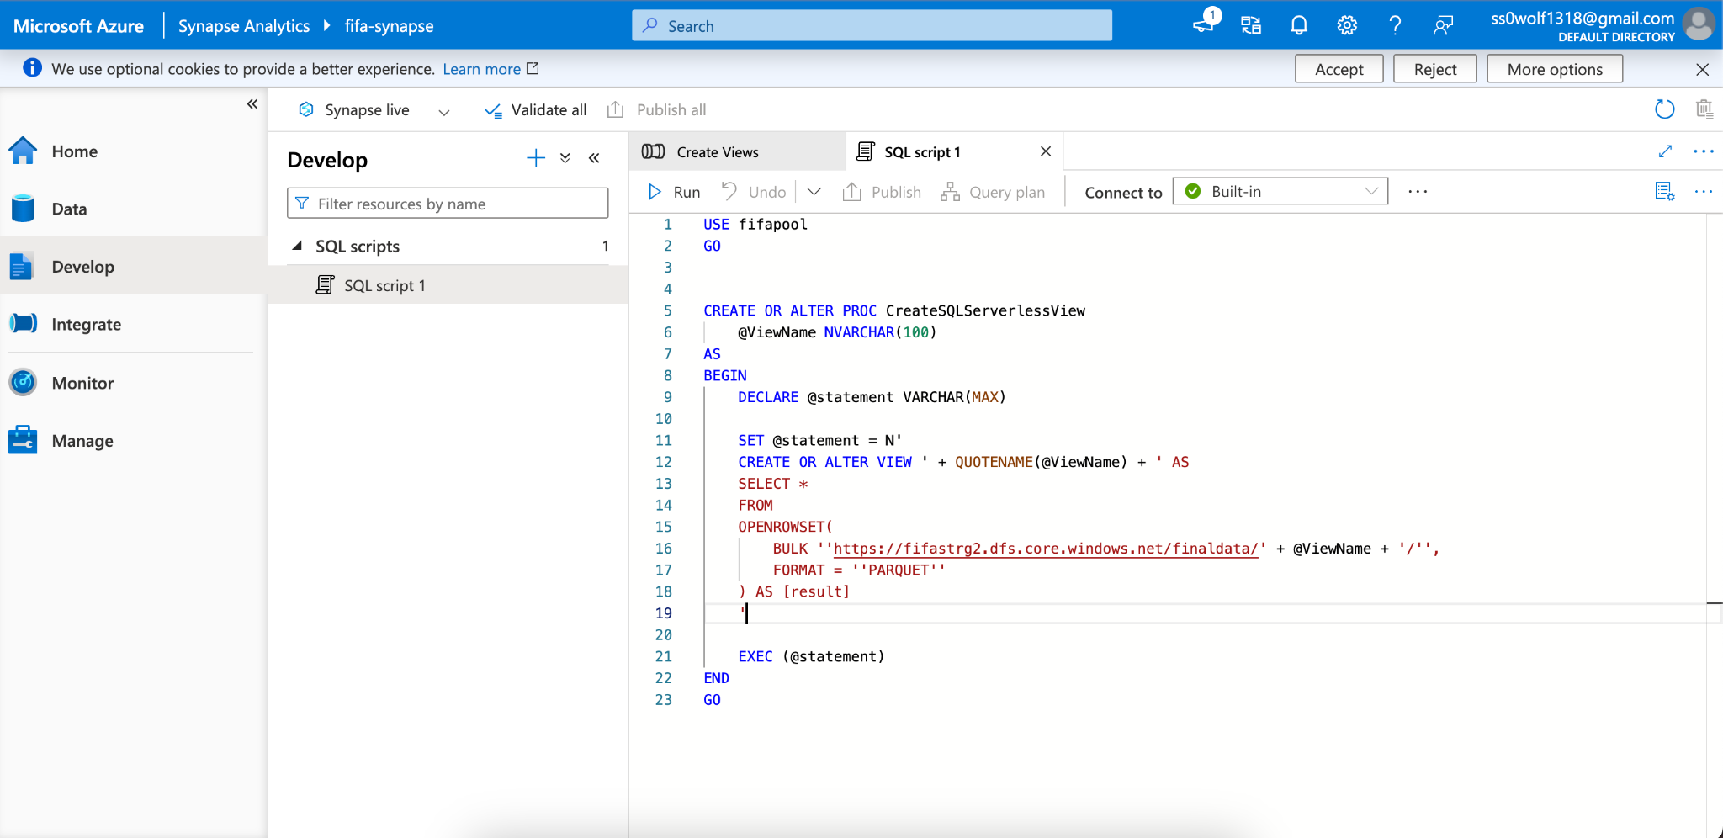
Stage 4: Data Modeling

Slide 22
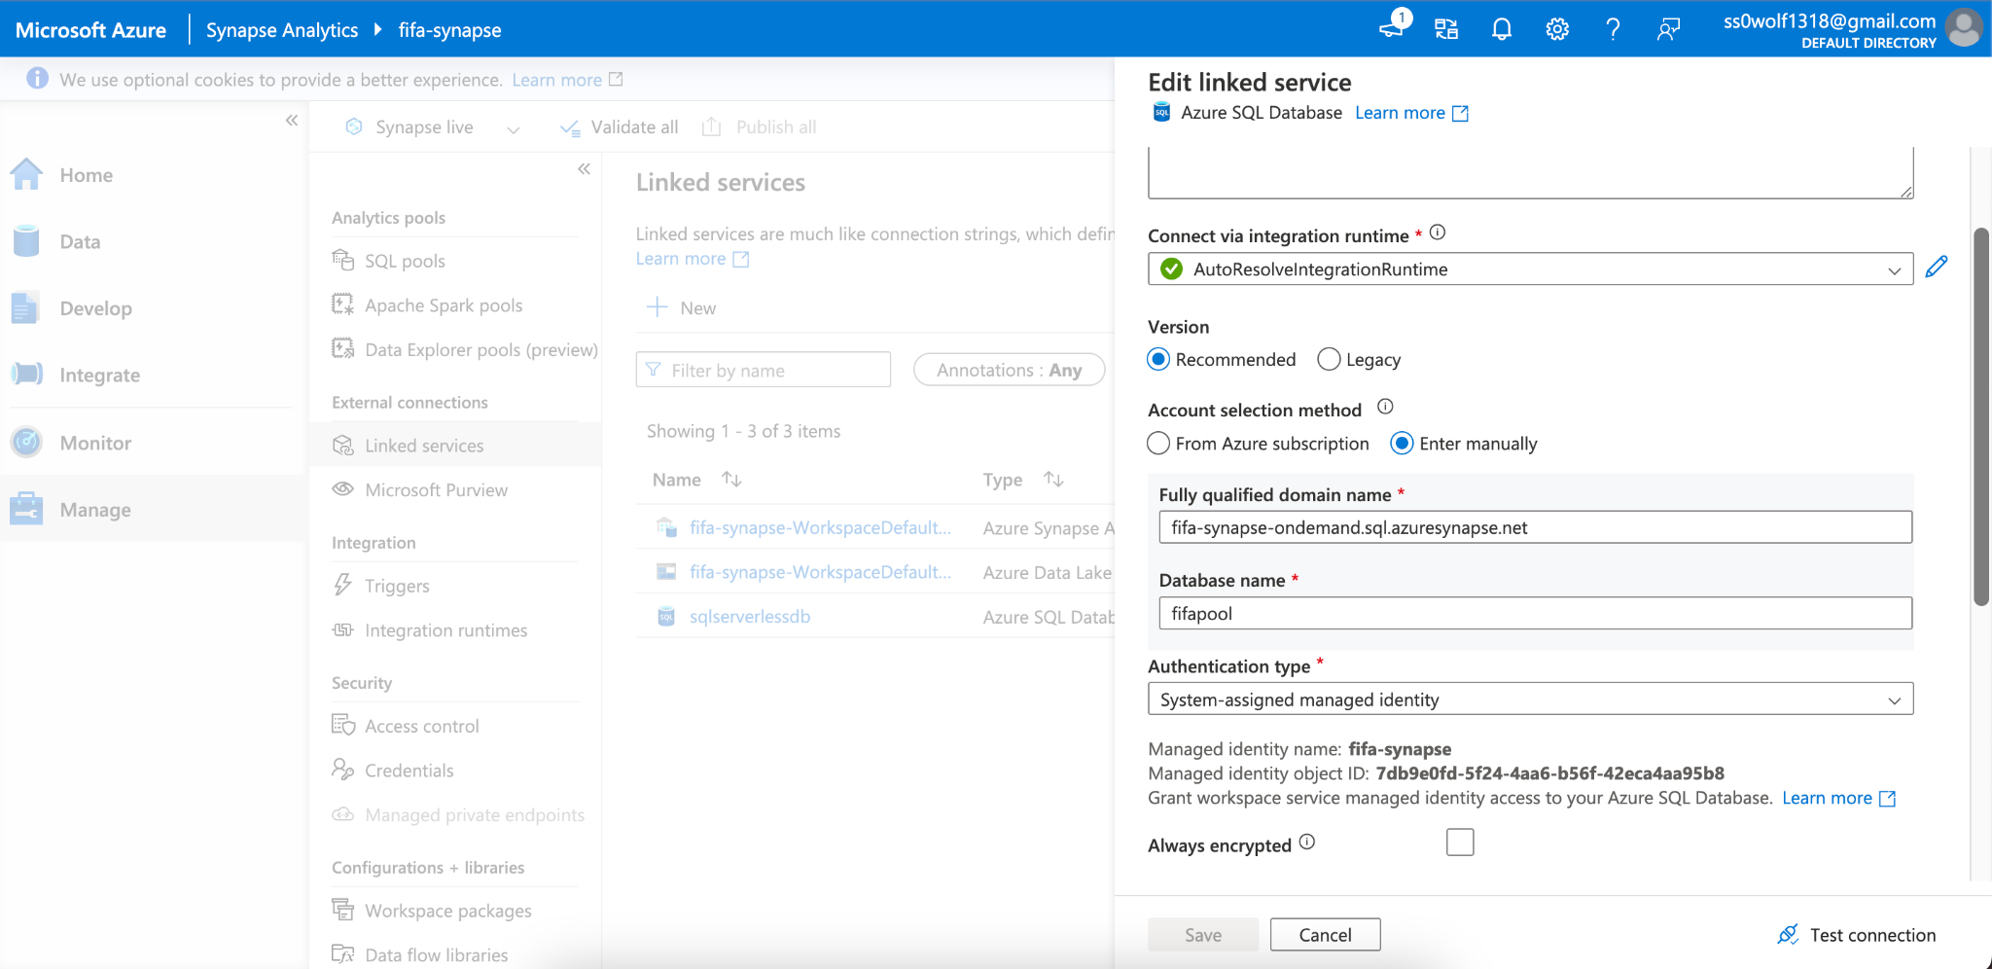
Stage 4: Data Modeling

Slide 23
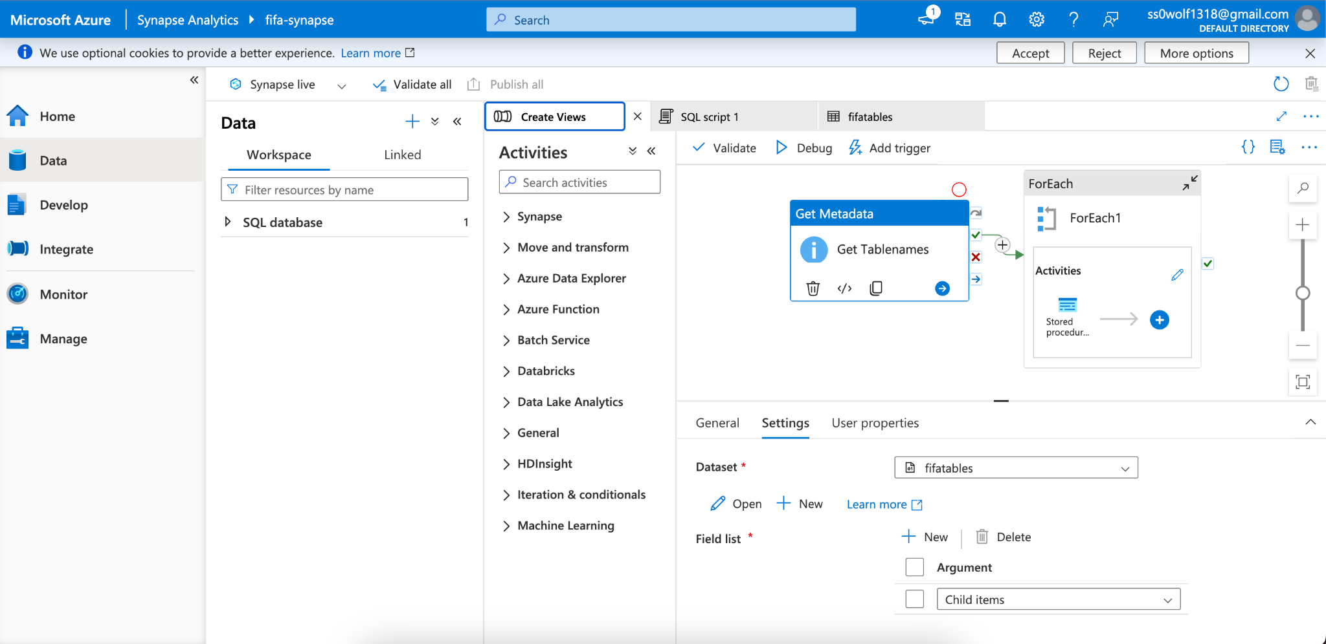
Stage 4: Data Modeling

Slide 24
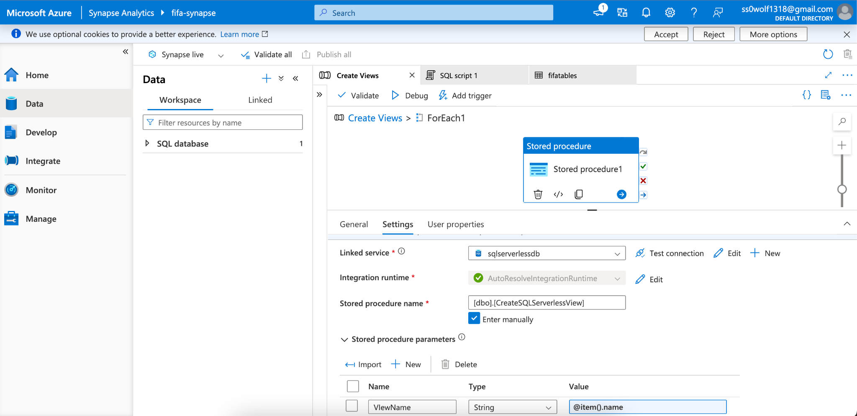
Stage 4: Data Modeling

Slide 25
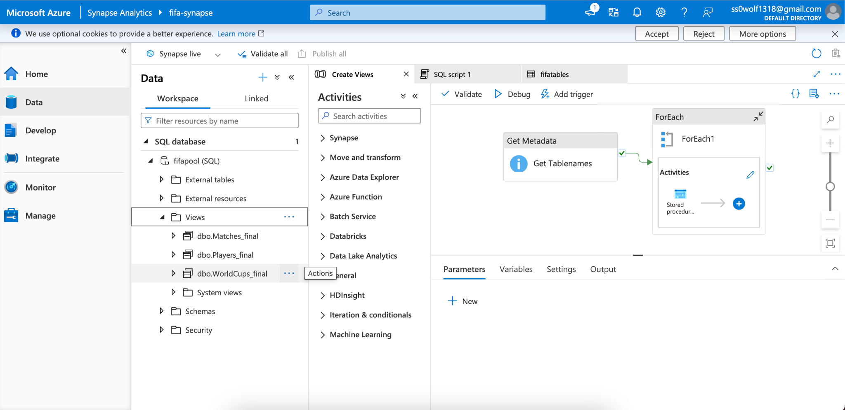
Stage 4: Data Modeling

Slide 26
Stage 5: Data Visualization
Analyzing Data Using Power BI
Overview of Created Charts and Insights

Slide 27
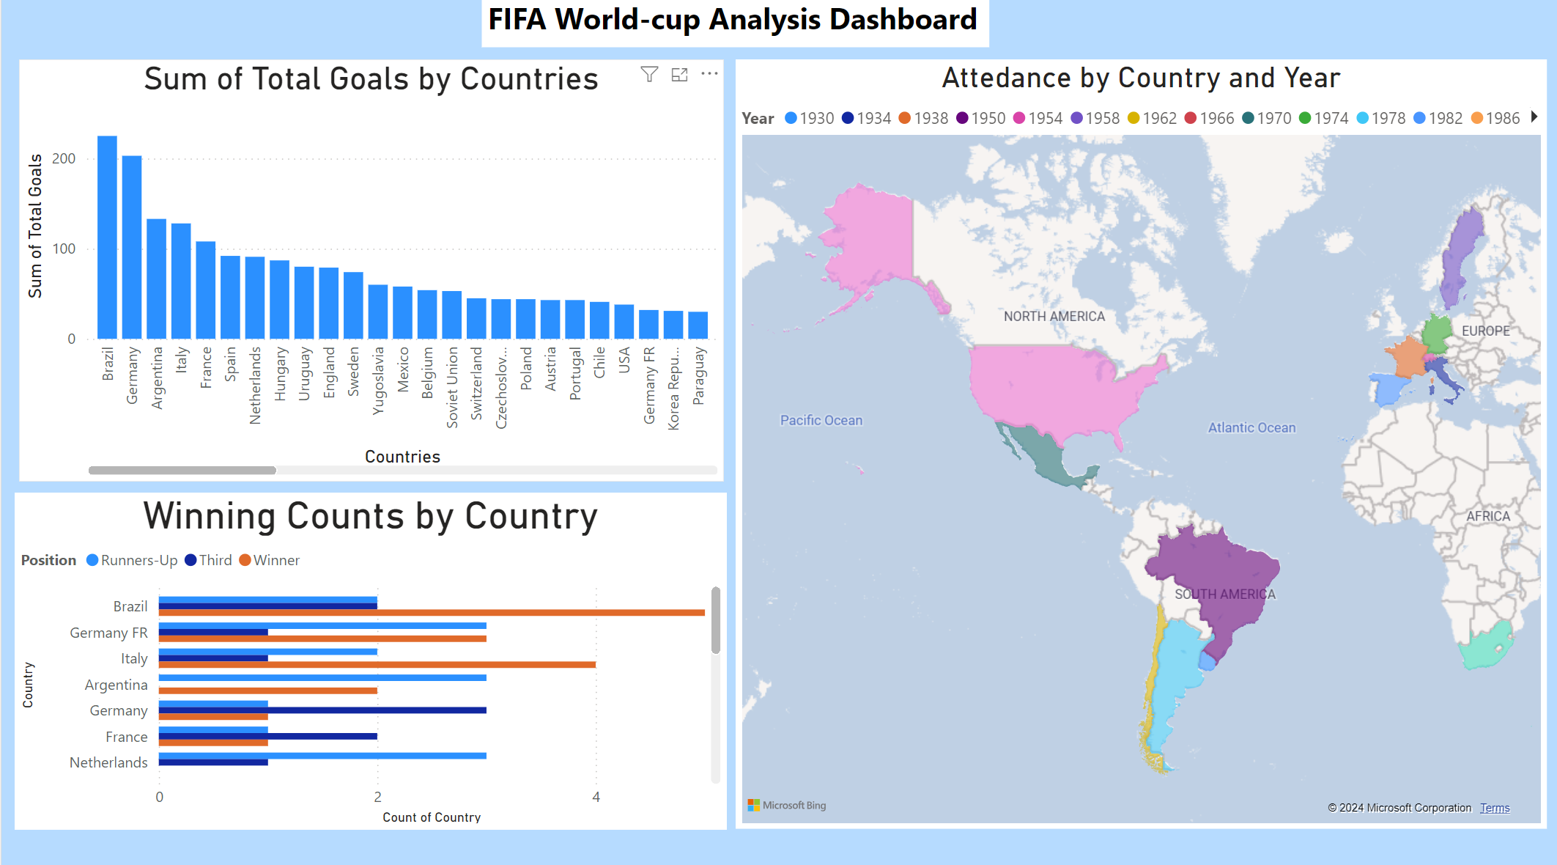
Stage 5: Data Visualization

Slide 28
Conclusion
This project successfully utilized Azure’s powerful suite of tools to analyze FIFA World Cup data. Key achievements include:
Efficient Data Pipeline: Automated data ingestion, transformation, and modeling using Azure Data Factory, Databricks, and Synapse.
Secure Data Management: Ensured data security with Azure Key Vault.
Insightful Visualizations: Generated meaningful insights through Power BI dashboards, highlighting key trends in World Cup history.

